Slide 1
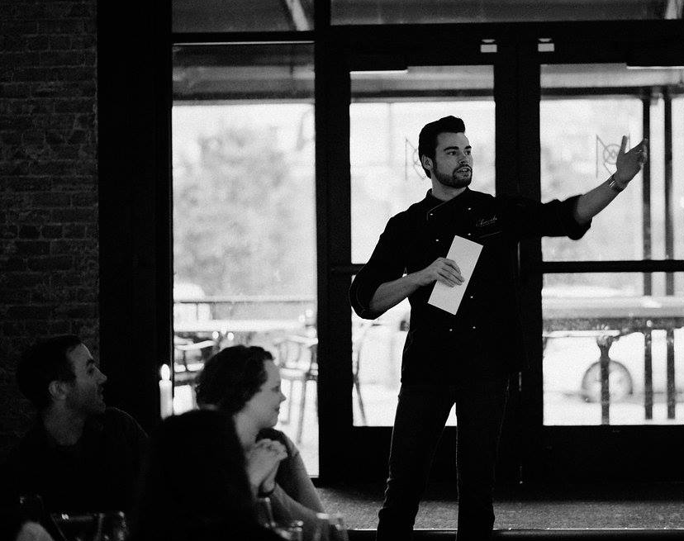
Can I predict crowd pleasing menus based on historical data?
Context: Joshua Young founded a custom catering company 2016 -2019.
All photos are original works.

Slide 2
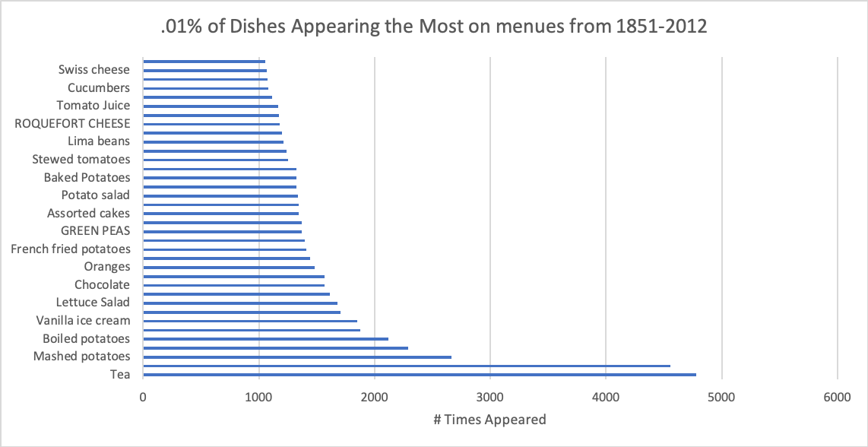
Incorporate tea in your menus as historically it is a robust menu item.
Interpretation of this insight uses the Lindy Effect.
“a theory that the future life expectancy of some non-perishable things like a technology or an idea is proportional to their current age, so that every additional period of survival implies a longer remaining life expectancy. Where the Lindy effect applies, mortality rate decreases with time.” Wikipedia

Slide 3
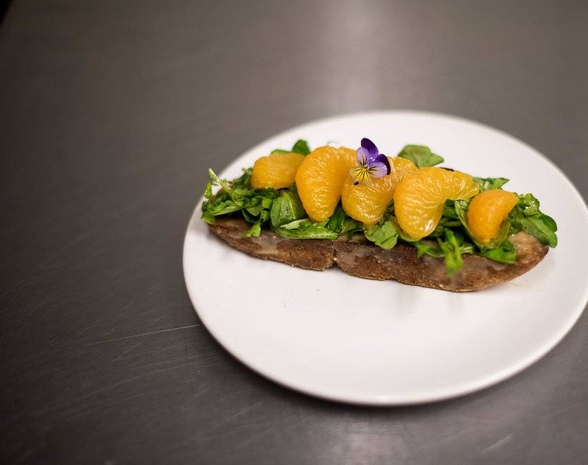
Incorporating tea into menus:
A/B test a multi course dinner paired w/ tea and not paired w/ tea
  Provide a portion of your customers an offer for a 3-course dinner paired with tea and another group a 3-course dinner no pairings.
  Test assumption that more people will be interested, i.e. a higher rate of conversation, for a dinner paired with tea.
1st Course. Coffee Tartine Sumatra Bread
arugula, mandarin orange, pine nut butter, coffee dressing

Slide 4
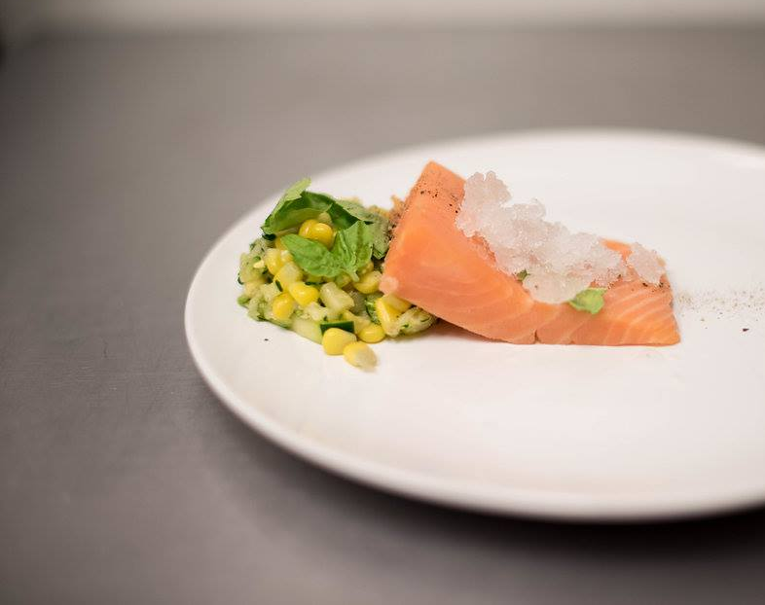
A/B Test Menu
Menu A priced @ 66% of COGS
  Abacha African Salad: spinach, sweet cassava root and soft-boiled eggs.
    Menu B includes: Rooibos Tea
  Argentinean Chicken Fried Steak: thin chicken breast breaded and battered, ham, tomato, mozzarella and chimichurri.
    Menu B includes: Yerba Mate
  Chocolate Cinnamon Scone: cinnamon chips, dark chocolate glaze, with vanilla bean custard.
    Menu B includes: Chai Tea
2nd Course Mi-Cuit Salmon
zucchini corn salad, white wine rosemary granita

Slide 5
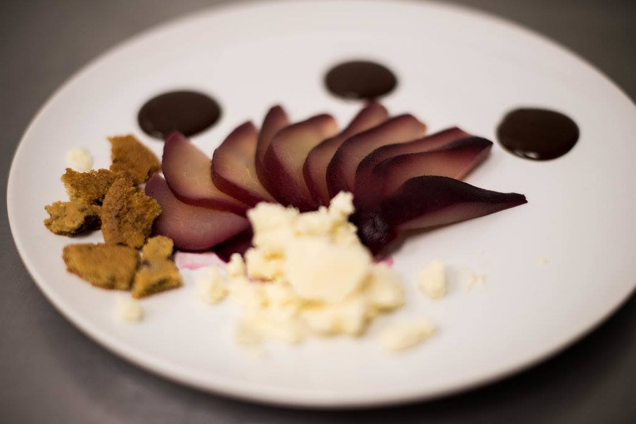
A/B Test Parameters
  Both dinners tickets priced at 66% markup from COGS.
  Same: night, menu and venue.
  Use people’s conversation of each
  dinner as the key metric to run power tests.
3rd course Poached Pear
ganache, chocolate chip cookie
goat cheese ice cream

Slide 6
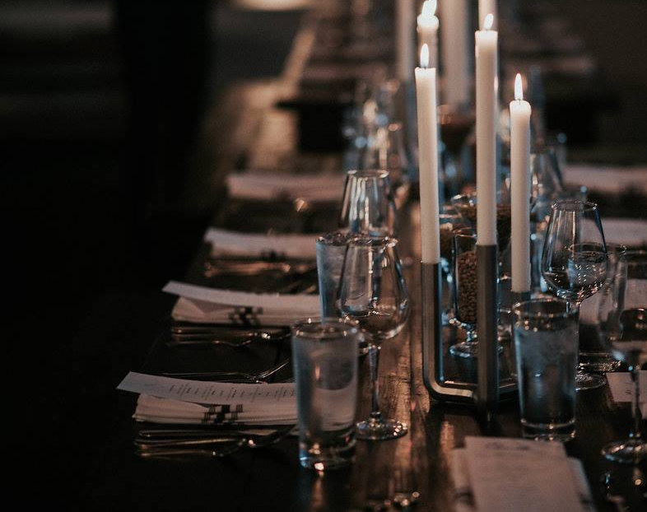
Hyperlinks
Data coming from Dish.csv on Kaggle:
  Note: I counted the following as errors in my graph rendering and did not use their data.
    Values: ‘0’ in Times Appeared.
    Values: ‘0, 1, 2928’ in First and Last Appeared
    Values: all negatives in Years Dish was on Menus

